Slide 1

Team Name : Geminators
Team Leader Name : Deepa Arul
Problem Statement : Automating Test Case Generation with AI

Slide 2
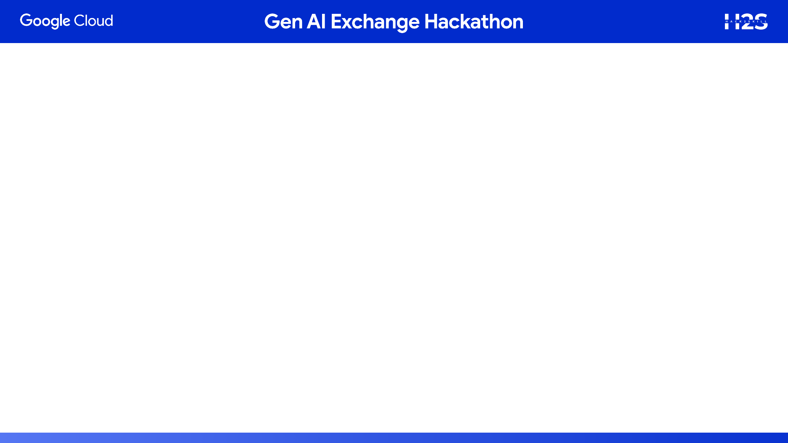
Brief about the prototype:
Key Features:
Requirement parsing & classification
Automated test case + pytest generation
Validation with ISO standards:
ISO 13485 (Medical devices – QMS)
ISO 14971 (Risk management)
ISO 62304 (Software lifecycle)
Results storage in BigQuery
Jira integration for traceability
Outcome: Demonstrates how AI + agent-based workflows can accelerate medical device software validation
Automating Test Case Generation with AI
Prototype Overview
Objective: Build an AI-powered pipeline to automate test case creation for insulin pump software.
Core Idea:
Input → Medical device requirements
Output → Structured test cases + pytest scripts
Technology Stack:
MCP Server for modular microservices
Agentic Flow using LangGraph to orchestrate agents
GitHub Source Code (base repo reference):
Personal Insulin Pump – Integrated System
.

Slide 4
How different is it from existing solutions?
Current solutions only focus on manual test case authoring or limited automation.
None combine Generative AI, MCP server microservices, and agentic workflows for end-to-end compliance automation.
Unique in integrating GitHub source code, ISO standards, and Jira for traceability.
🔹 How will it solve the problem?
Transforms natural language requirements into validated, executable test cases.
Automatically cross-checks with ISO/FDA standards for compliance.
Stores results in BigQuery, enabling audit-ready dashboards.
Reduces manual effort, accelerates release cycles, and lowers compliance risks.
🔹 USP (Unique Selling Proposition)
Agentic AI Flow: orchestrates requirement → test case → pytest → validation → Jira update.
MCP Server backbone: modular, scalable, and cloud-native.
Embedded compliance: ISO/FDA validation is part of the pipeline.
Future-ready extension:
Ability to generate synthetic samples (audio, video, sensor signals) using GenAI.
Covers domains where real samples are scarce or hard to collect (e.g., heartbeat, ECG/Echo signals).
Enables end-to-end validation pipelines with realistic test data generation.

Slide 5
Features of the Solution
✅ Requirement Processing
Reads natural language requirements from GitHub/inputs.
Parses and classifies them automatically.
✅ Automated Test Case Generation
Generates structured test cases and pytest scripts using AI.
Links test cases to requirement IDs for traceability.
✅ Compliance Validation
Cross-checks with ISO 13485, ISO 14971, ISO 62304 standards.
Flags gaps, hazards, or risks during validation.
✅ Execution & Results Management
Executes tests on MCP server pipeline.
Stores results in BigQuery for dashboards & audits.
✅ Agentic Workflow
Orchestrates agents (requirement → test case → ISO check → Jira update).
Provides modular scalability.
✅ Integrations
Jira: automatic update of issues & traceability.
GitHub: pull source requirements directly.
✅ Future Extension
Generate synthetic samples in audio/video formats (e.g., heartbeat, echoes).
Enables testing where real-world data is scarce.

Slide 6
Process flow diagram or Use-case diagram
Add a flow diagram or a use case diagram or an architecture diagram.

Slide 7
Wireframes/Mock diagrams of the proposed solution (optional)

Slide 8
Architecture diagram of the proposed solution

Slide 9
Technologies to be used in the solution: echnologies Used in the Solution
🔹 AI / ML & Orchestration
LangGraph → Agentic flow orchestration
MCP Server → Modular microservice pipeline
Generative AI Models → Requirement parsing, test case generation, synthetic sample creation
🔹 Cloud Infrastructure (GCP)
Google Cloud Storage (GCS) → Store synthetic samples (audio, video, signals)
BigQuery → Store & analyze test results, enable dashboards
Cloud Run / Cloud Shell → Deploy and run MCP microservices
🔹 Integration & DevOps
GitHub → Requirement source code repository
Jira → Traceability, requirement → test case linkage
CI/CD Pipelines → Automate builds & deployments
🔹 Testing & Compliance
Pytest → Automated test execution
ISO Standards → ISO 13485, ISO 14971, ISO 62304 for compliance validation
🔹 Programming & Tools
Python (FastAPI, Uvicorn) → Core implementation
VS Code → Development environment
Docker → Containerization

Slide 10
Estimated implementation cost (optional): Estimated Implementation Cost (Indicative)
🔹 Cloud Infrastructure (GCP)
Compute (Cloud Run / VMs / Cloud Shell) → ~ $100 – $200 / month (prototype scale)
Storage (GCS for synthetic samples) → ~ $20 – $50 / month (depends on sample volume)
BigQuery (test results & dashboards) → ~ $50 – $100 / month (light querying during prototype, can scale)
🔹 Development & Integration
MCP Server + LangGraph Agents → Open-source (no license cost)
FastAPI, Pytest, Python packages → Free / Open-source
GitHub Integration → Free (basic) or ~$4–$20 / user / month (Pro/Enterprise)
Jira Integration → ~$8 / user / month (Standard cloud plan)
🔹 Optional Extensions
Generative AI APIs (Gemini, OpenAI, etc.) → ~$100 – $300 / month (for text + synthetic audio/video generation, depends on usage)
💰 Estimated Prototype Cost (3–6 months)
👉 $500 – $1,000 / month (for a small-scale prototype with ~5 users).
⚡ Scales up based on:
Number of test cases
Volume of synthetic sample generation (audio/video)
Team size (Jira/GitHub licenses)
Compliance requirements (extra audits / premium features)

Slide 11
Add as per the requirements for the hackathon:

Slide 12


